Slide 1
Dealing with drama in the workplace
Paul Meigio
MBA

Slide 2
Human resources

Slide 3
outline

Slide 4
Definition
Drama; any situation or series of events having vivid, emotional, conflicting, or striking interest or results.

Slide 5
Climate vs. culture

Slide 6
Ground rules
There is no right or wrong culture per se
Matching the right culture
To the industry
To the business
To the national and local culture
To the consumer/market

Slide 7
Types of Cultures

Slide 8
ARTIFACTS
ESPOUSED VALUES
ASSUMPTIONS

Slide 9
The rip current

Slide 10
The approach

Slide 11
institution

Slide 12
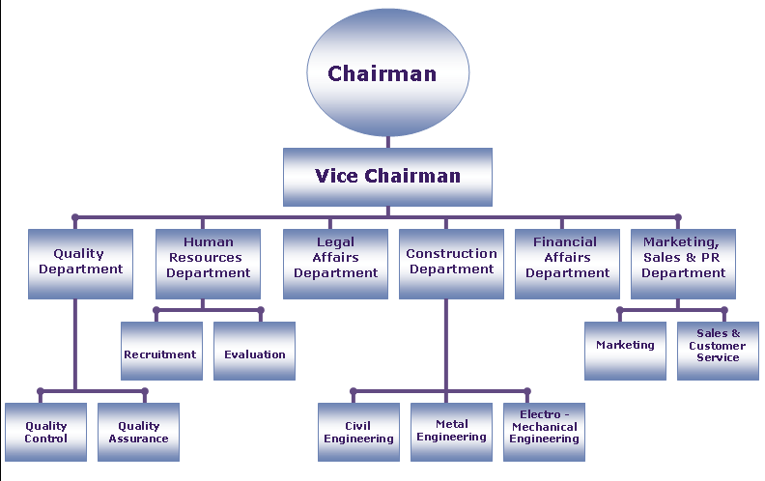
Traditional Hierarchy

Slide 13
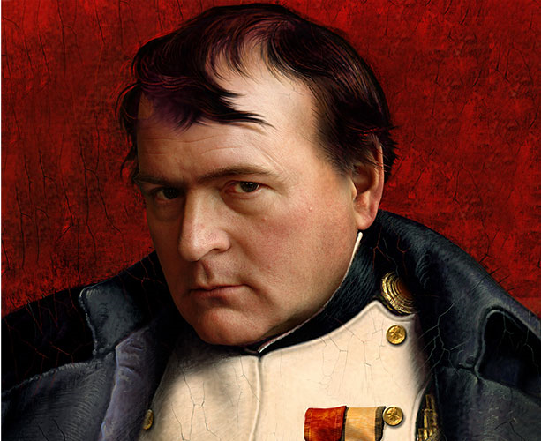
Responsibility vs. obedience
A commander is not protected by an order from a minister or prince who is absent from the theater of operations and has little or no knowledge of the most recent turn of events. Every commander responsible for executing a plan that he considers bad or disastrous is criminal.
INTRAPRENEUR

Slide 14
Company identity
Mission Statement
Vision Statement
Core Values
Core Competencies
Strategic Plans

Slide 15
Mission statement examples
Harley Davidson
We fulfill dreams through the experience of motorcycling, by providing to motorcyclists and to the general public an expanding line of motorcycles and branded and services in selected market segments.
Ford Motor Company
We are a global family with a proud heritage passionately committed to providing personal mobility for people around the world.

Slide 16
Mission statement examples
Coca Cola
To refresh the world. To inspire moments of optimism and happiness. To create value and make a difference.
Nike
To bring inspiration and innovation to every athlete in the world.
IBM
Operating a safe and secure government

Slide 17
Core values
Make it a reality
Make it crystal clear
Be succinct and to the point
It has to be from your soul
Knowing-doing gap

Slide 18
examples

Slide 19
examples

Slide 20
examples

Slide 21
Institution phase 2

Slide 22
Getting on the bus
40% of new employees fail within 18 months of being hired. 89% of the reason is due to the attitudes and behaviors that don’t fit into the culture

Slide 23
Intake process
Ask the KSAs and….
Invite other employees to be on the interview team
Rehire, would you do it over again?
What are you really looking for? How do you ask questions to find out?

Slide 24
Performance evaluations

Slide 25
Impacting not changing

Slide 26
WELCOME BACK KOTTER

Slide 27
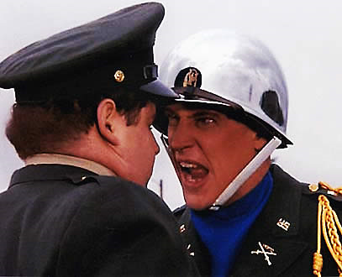
Start with yourself
What are your core values?
The sleep factor
Least preferred coworker scale
Employment Core Values Exercise

Slide 28
Ride the wave

Slide 29
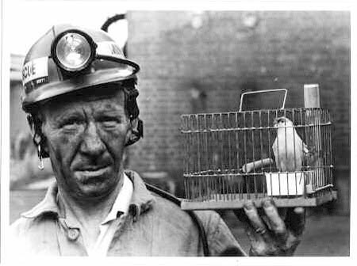
Listen to language

Slide 30
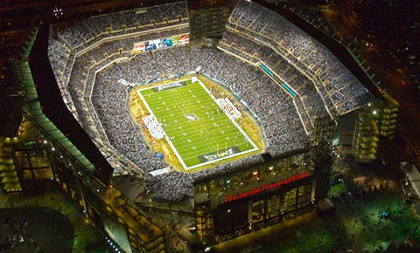
Where are you?

Slide 31
Its all about relationships
People follow who they like
Don’t try to make everyone just like you!
Show that you value the person
Triads and group

Slide 32
How to deal with
Don’t force it, forge it
Role model the behavior, attitudes, and language you want to see in the workplace
Accentuate the positives
Mobilize the partnerships and working relationships
Avoid the no-win arguments

Slide 33
pmeigio@co.bonneville.id.us
Q & A

